Slide 1
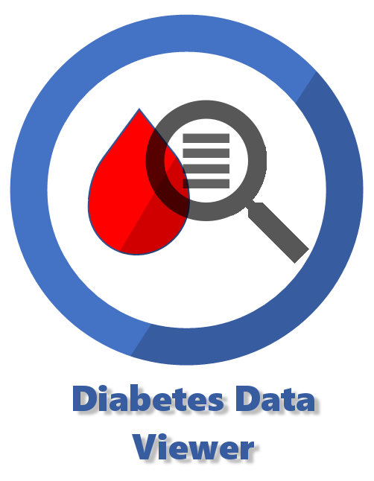
Visual Dashboard
And Predictive Analytics
For Pediatric Endocrinology
U-HACK MED TEAM 10

Slide 2
Problem
“Data is not Knowledge”
New data is generated daily.
Physicians often don’t have a team of dedicated developers to create, run, and update software solutions.
Notes:
Patients with Type 1 Diabetes generate large volumes of data (demographics, lab results, and unique to them, thousands of glucose values/day).
Some form of automation is needed.

Slide 3
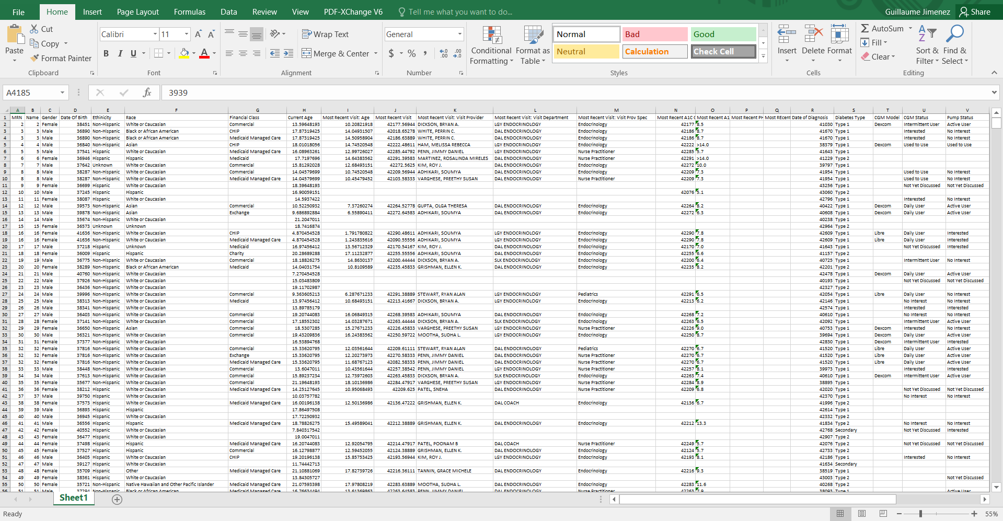
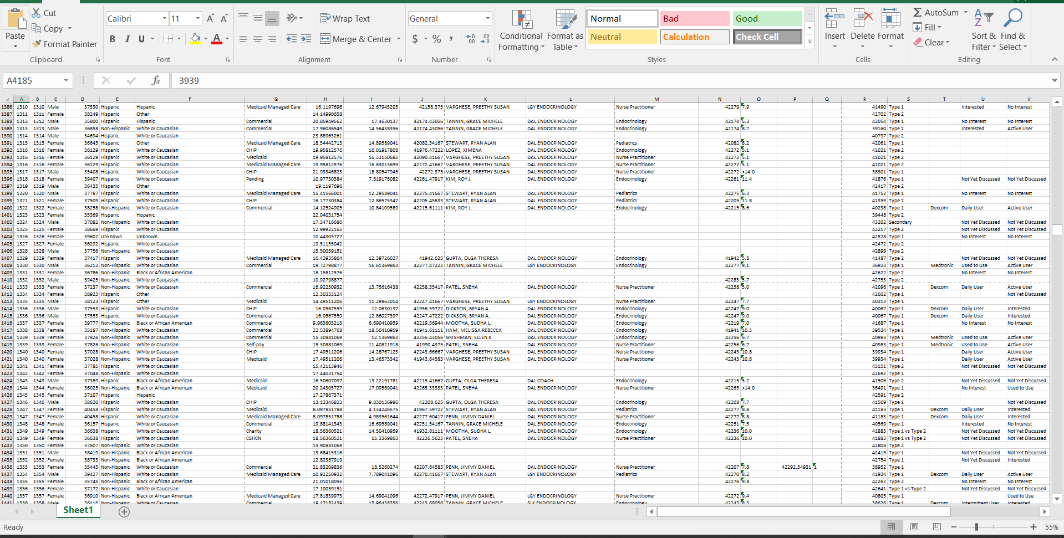
We’re starting with this...
- 4 files of raw data (so far)
- 4200+ rows each
- ½ million data points

Slide 4
Challenge Accepted
Can this data be visualized to better understand what it tells us?
Can the visualization tools empower physicians to update, modify, and explore the data on their own?
Can we use our data for a patient in one year to predict outcomes in the following year?

Slide 5
Plan
Data exploration: using a user friendly GUI framework to generate dashboards on the fly.
Optimization problem to identify patient readmission risk based on available features.

Slide 6
Power BI On-The-Fly
Because Microsoft BI is a tool available to our team lead, that is quick to learn, can be integrated with R, and lends itself to sustainability, we explored using it as a data visualization tool. 20 hours of learning produced….

Slide 7
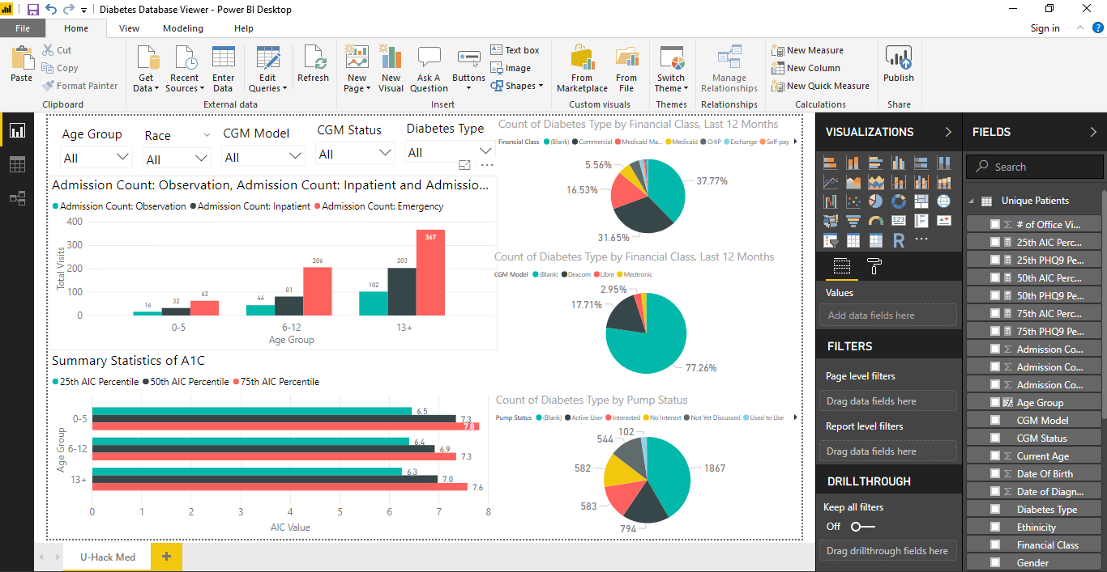

Slide 8
An open-source approach
We developed a flask app and leveraged matplotlib to create interactive charts.
User can select any feature of the data
Easily expandable and customizable (for a dev team)

Slide 9
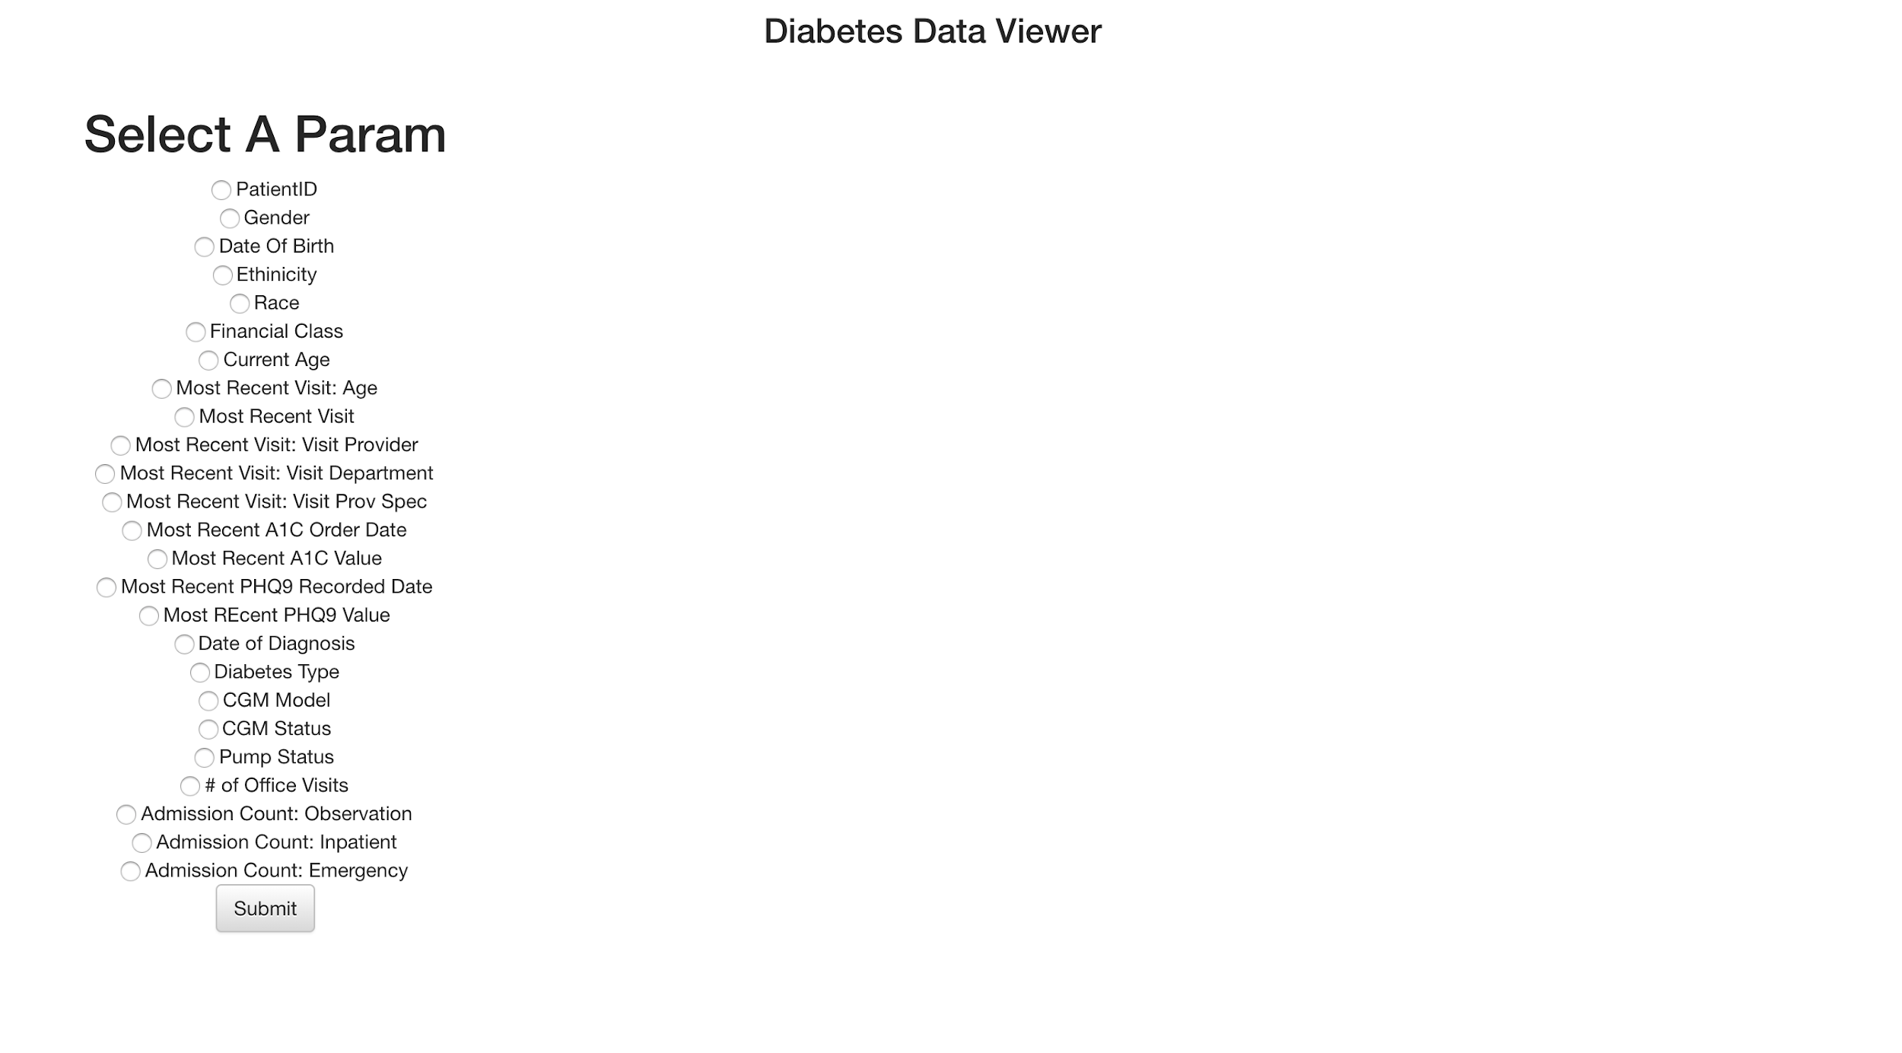
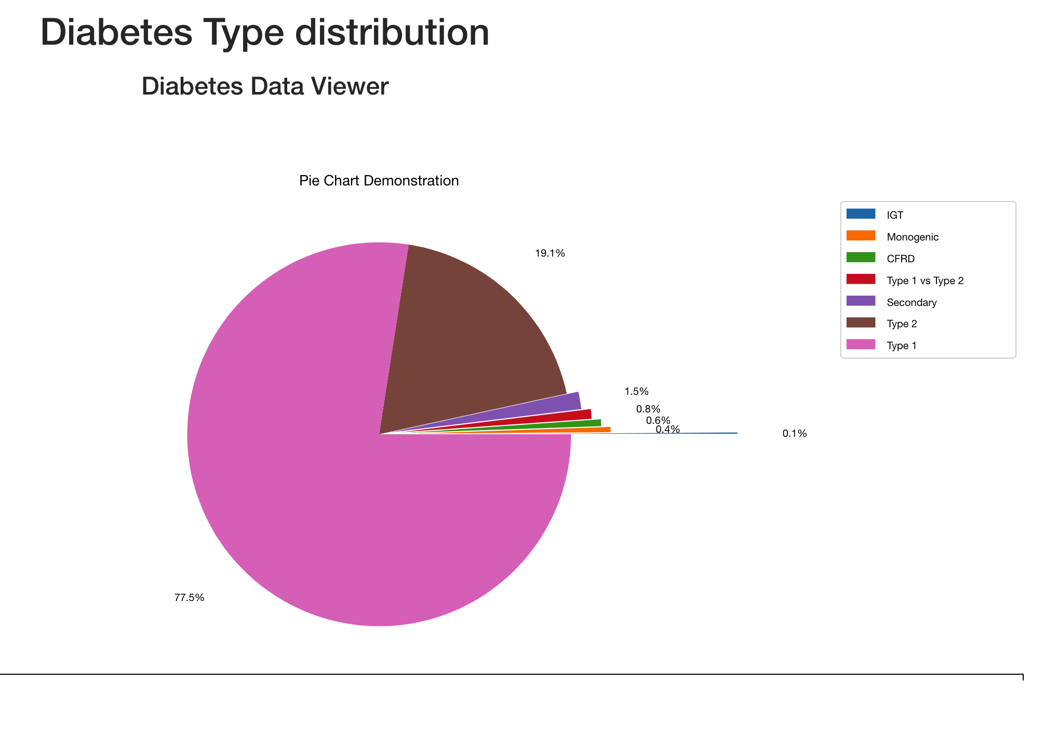
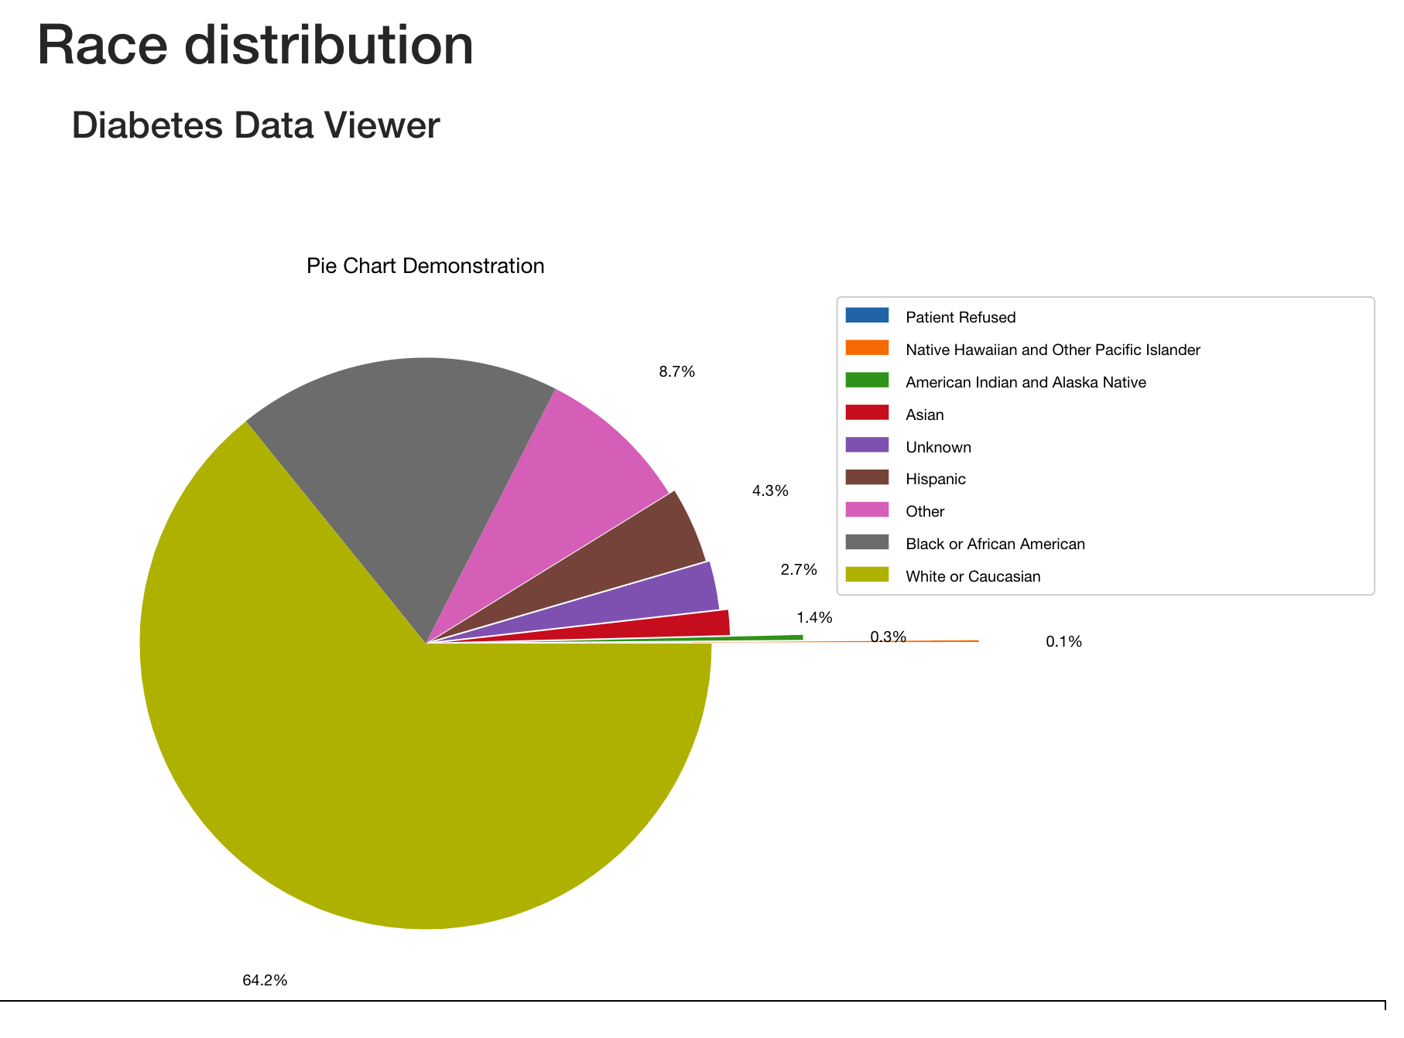
Diabetes Type Distribution
Race Distribution

Slide 10
Linear regression to predict the likelihood of patient behavior
Used regression model to predict patient behavior in the following year
Predicted the likelihood that patients will be admitted:
Model does not yet predict the 10% of patients who are readmitted any given year

Slide 11
Thank You U-Hack Med!

